Slide 1
DOST-ITDI Activities on Clean Water, Sanitation and Sewerage
1st Negros Water Summit
Negros First Hostel
Bacolod City, Negros Occidental
February 27-28, 2020
February 19-22, 2020
Reynaldo L. Esguerra
Chief SRS, DOST-ITDI
rlesguerra@itdi.dost.gov.ph

Slide 2
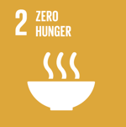
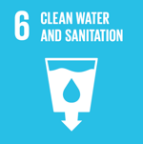
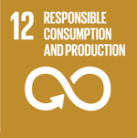
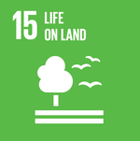
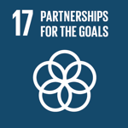
https://sustainabledevelopment.un.org/sdgs

Slide 3
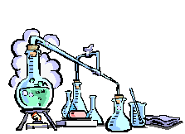
Multi-media Transfer of Pollution
APCD
WTP
LANDFILL
SLUDGE
LEACHATE
GROUNDWATER

Slide 4
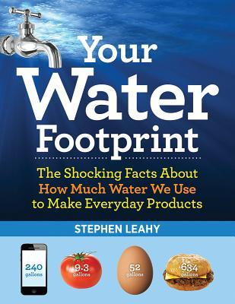
Water Footprint of a 500-mL soda
https://cdn4.vectorstock.com/i/1000x1000/81/08/cola-bottle-icon-soda-bottle-with-red-lable-vector-23318108.jpg
Item | Amount of Water (L)
Soda | 0.5
HFMS (corn) | 30.0
Flavouring - vanilla | 80.0
Flavouring - coffee | 53.0
Plastic bottle | 5.0
Packaging, shipping, etc. | 6.5
TOTAL | 175
500 mL
“The water footprint is a measure of humanity’s appropriation of fresh water in volume of water consumed and/or polluted”
https://waterfootprint.org/en/water-footprint/what-is-water-footprint/
Stephen Leahy. Your Water Footprint: The Shocking Facts About How Much Water We Use to Make Everyday Products (New York: Firefly Books (US), Inc., 2014), pp. 8-9

Slide 5
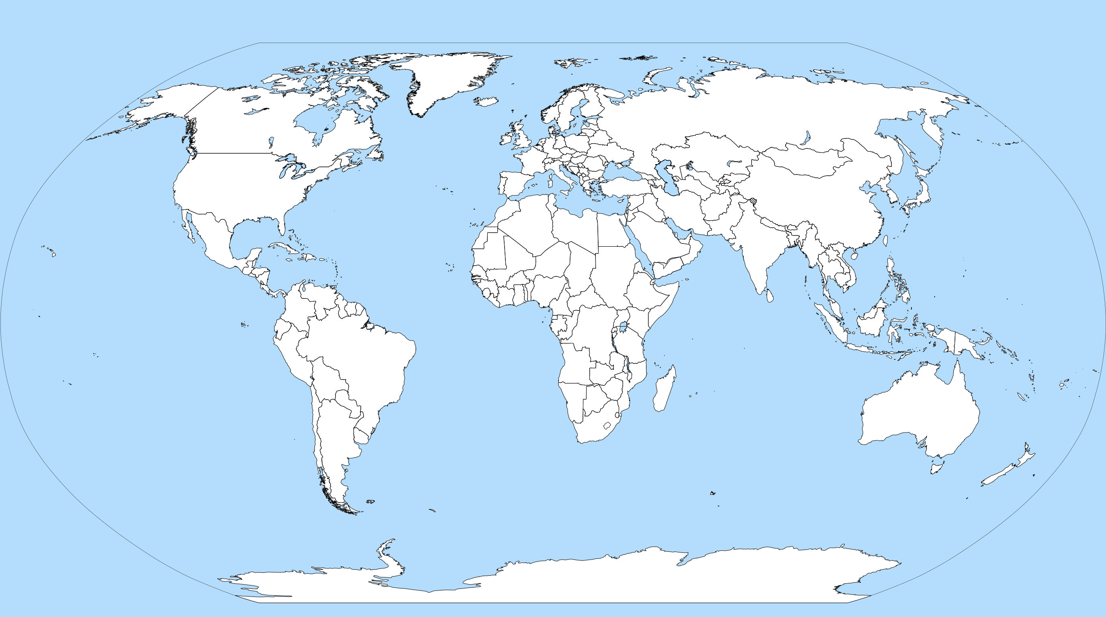
Russia
76.7
USA
482.2
Iran
93.3
Pakistan
183.5
China
578.9
Japan
88.4
Mexico
79.8
India
761.0
Philippines
78.9
Indonesia
82.8
Top 10 Freshwater Extracting Countries
Stephen Leahy. Your Water Footprint: The Shocking Facts About How Much Water We Use to Make Everyday Products (New York: Firefly Books (US), Inc., 2014), p. 39

Slide 6
Material Balance Model
Raw
materials
Finished
products
100
90
90
80
80
Product w/ negative economic value
Waste
10
20

Slide 7
Waste Management Hierarchy
SOURCE REDUCTION
ON-SITE RECYCLING
Off-site Recycling
Treatment
Disposal

Slide 8
Source Reduction
Product
Changes
Process Changes
Input Material Changes
Technology Changes
Improved Operating
Practices

Slide 9
Technology Change
Before
BOD reduction from 250 to 149 mg/L
2,000 m³/year water savings
100 kg/yr treatment chemical reduction
After

Slide 10
Improved Operating Practices
864 m³/year water savings
115 m³/yr water savings
6 kg treatment chemical reduction
Solid Wastes
During Washing
Area (mg/L) | Before | After
Tray Washing | 318 | 56
Picking | 250 | 149
Receiving | 366 | 20
Go to Drain!
No standard amount of water used in Pasteurization
BOD reduction/year = 850 kg

Slide 11
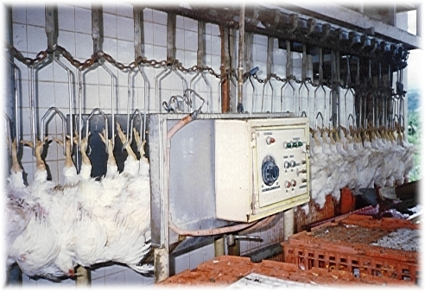
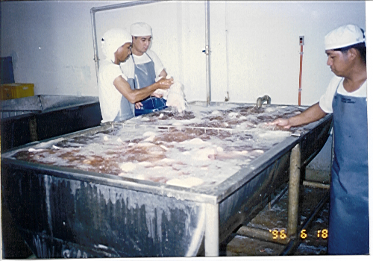
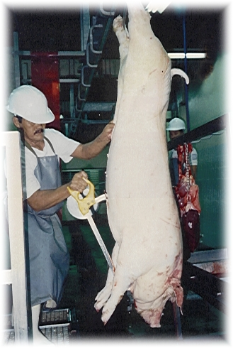
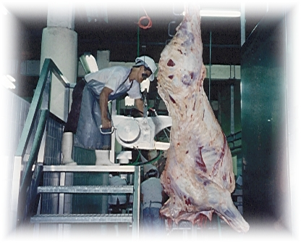
RESOURCE EFFICIENT & Cleaner Production
PRODUCTIVITY
WASTE
PRODUCTIVITY
PRODUCTIVITY
WASTE
PRODUCTIVITY
WASTE
PRODUCTIVITY
WASTE
WASTE
Notes:
DOST believes that Philippine industries can be further competitive in the current emerging trend of globalization through increase productivity and less waste generation if we can supplement the software side of cleaner production with the hardware, that is clean technology.

Slide 12
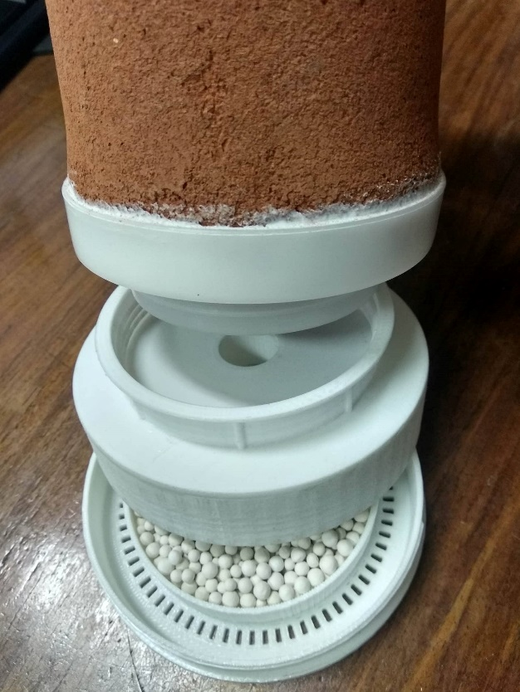
Issue: Lack of HH access to potable water
Emergency Disinfection of Drinking Water
(EDs)
Community-Based Water Treatment System
(ComWATS)
Household ceramic water filter
Portable rain water collector

Slide 13
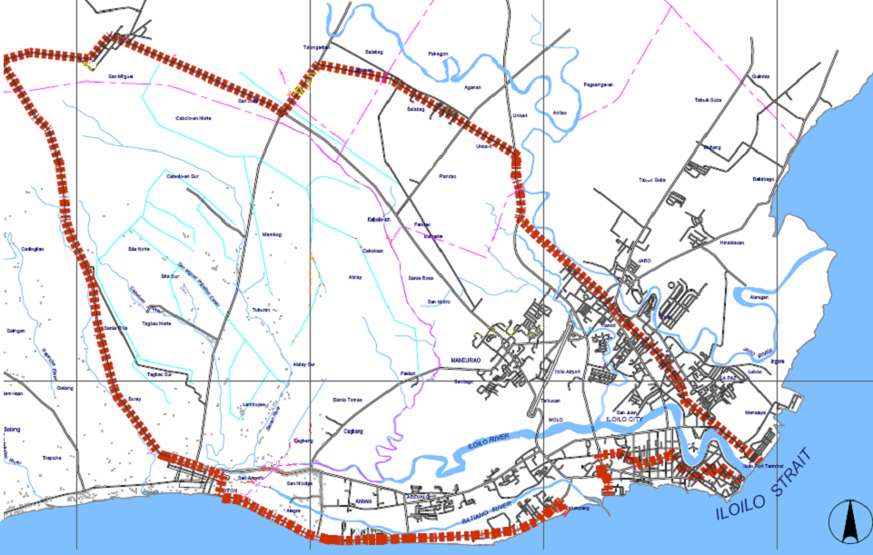
Issue: Monitoring of Water Quality
San Miguel
Sta. Barbara
Pavia
WQMA
Oton
Iloilo City

Slide 14
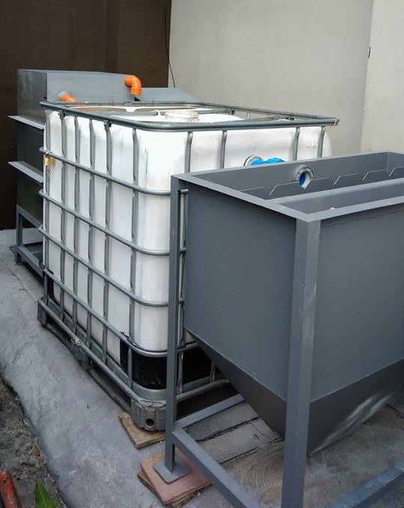
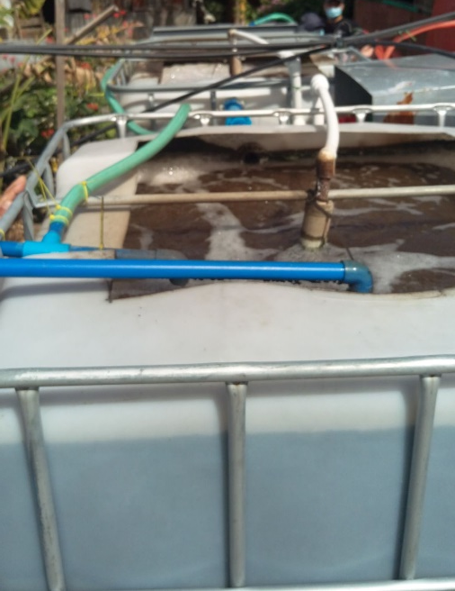
Issue: Pollution of Water Resources
Aerobic Treatment of Anaerobically Pre-digested Swine Wastewater
ITDI’s Wastewater Treatment System for QSRs

Slide 15
Treatment Objectives
Recycle
Sewer line discharge
Effluent standards
Irrigation
Receiving quality guidelines
Anticipated trends in regulations
Drinking water
Other regulatory considerations:
Building code
Occupational health and safety
Local ordinances

